Slide 1

Semidefinite Relaxations of Truncated Least-Squares in Robust Rotation Search
Orals 3 (Tue. pm) @ ECCV 2022
Liangzu Peng Mahyar Fazlyab René Vidal
Mathematical Institute for Data Science, Johns Hopkins University

Slide 2
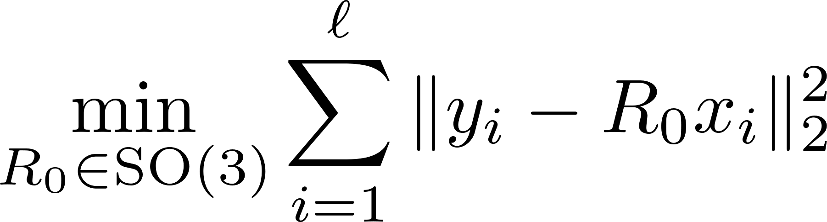
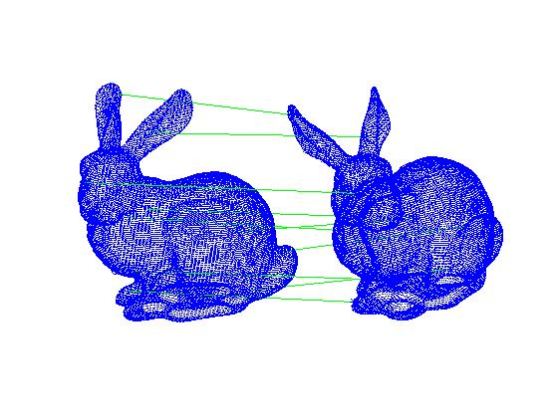
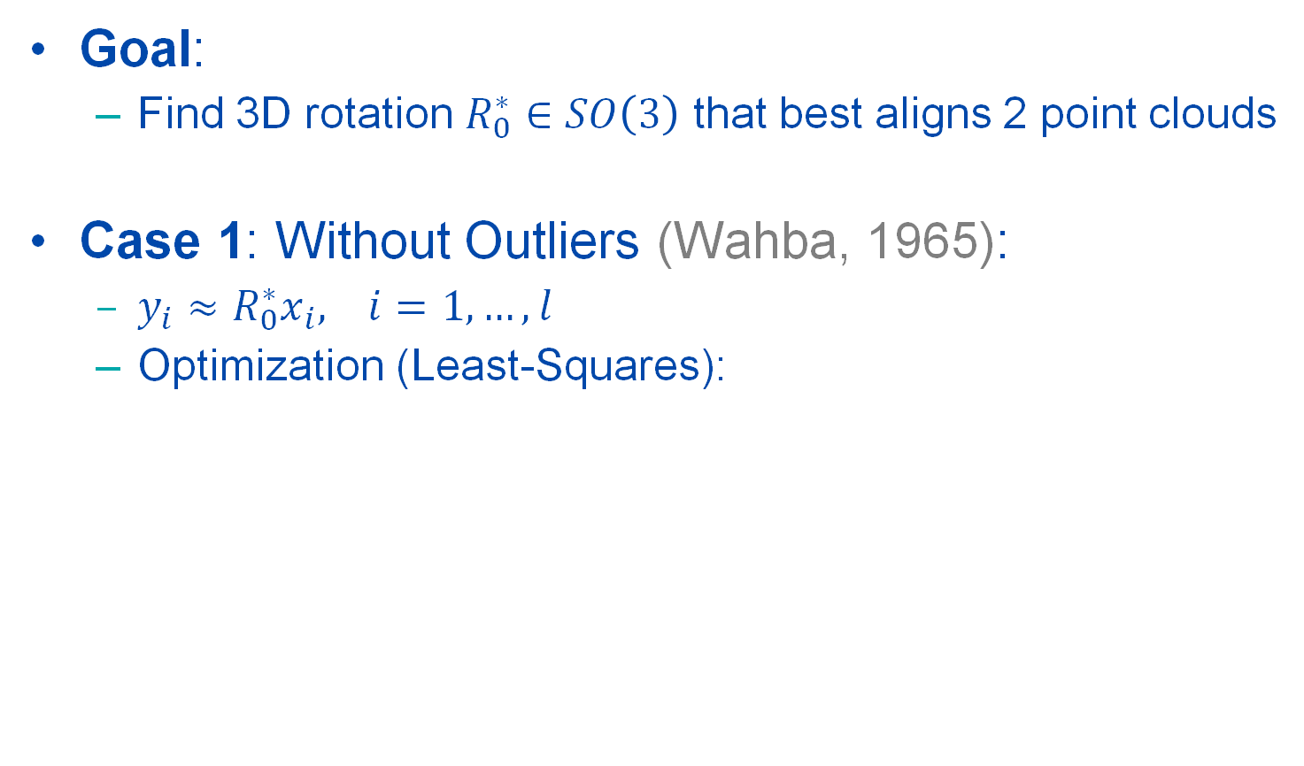
Problem: Outlier-Free Rotation Search
Goal:
Find 3D rotation $R_{0}^{∗}∈SO\left(3\right)$ that best aligns 2 point clouds
Case 1: Without Outliers (Wahba, 1965):
${{y_{i}≈R}_{0}^{∗}x}_{i}, i=1,…,l$
Optimization (Least-Squares):
[1] G. Wahba. A least squares estimate of satellite attitude. SIAM Review, 1965

Slide 3
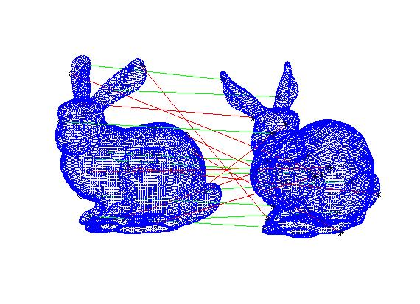
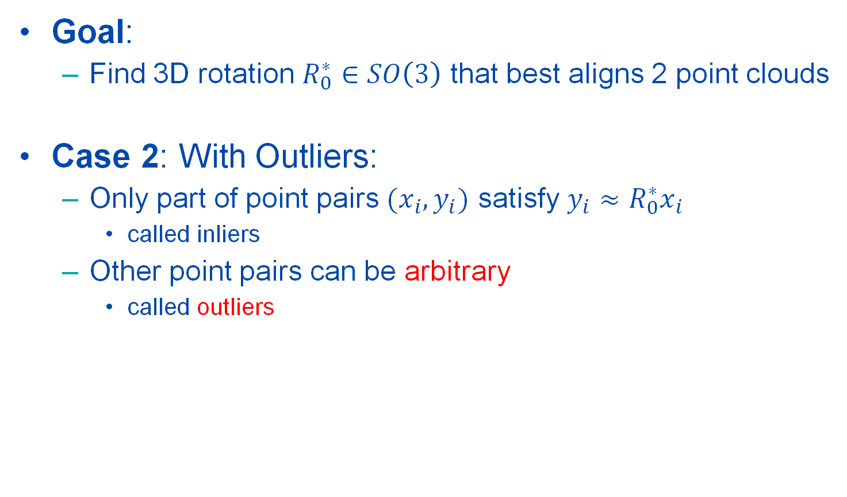
Problem: Outlier-Robust Rotation Search
Goal:
Find 3D rotation $R_{0}^{∗}∈SO\left(3\right)$ that best aligns 2 point clouds
Case 2: With Outliers:
Only part of point pairs $(x_{i},y_{i})$ satisfy ${{y_{i}≈R}_{0}^{∗}x}_{i}$
called inliers
Other point pairs can be arbitrary
called outliers

Slide 4
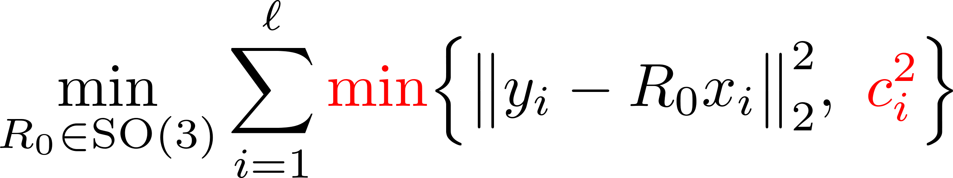
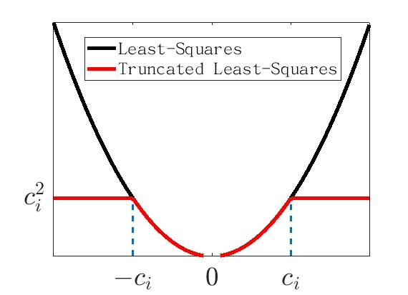
Truncated Least-Squares (Rotation)
(TLS-R)
(Huber, 1964) Truncation Parameter
Challenges of solving (TLS-R):
Non-Convexity
Non-Smoothness
Inapproximable (Antonante et al., 2021)
[1] H. Yang and L. Carlone. A quaternion-based certifiably optimal solution to the Wahba problem with outliers. ICCV 2019.

Slide 5
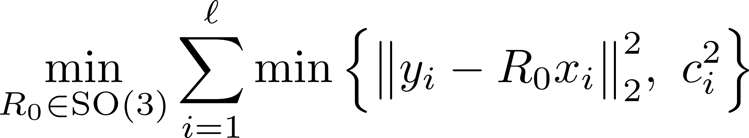
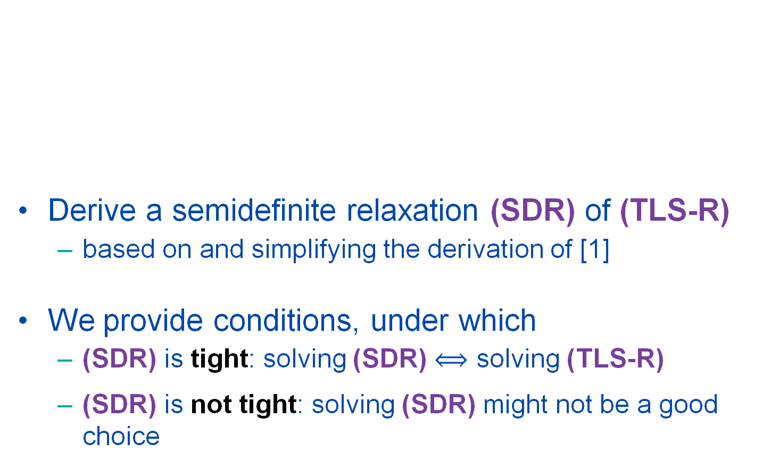
Our Contributions
Derive a semidefinite relaxation (SDR) of (TLS-R)
based on and simplifying the derivation of [1]
We provide conditions, under which
(SDR) is tight: solving (SDR) solving (TLS-R)
(SDR) is not tight: solving (SDR) might not be a good choice
(TLS-R)
[1] H. Yang and L. Carlone. A quaternion-based certifiably optimal solution to the Wahba problem with outliers. ICCV 2019.

Slide 6
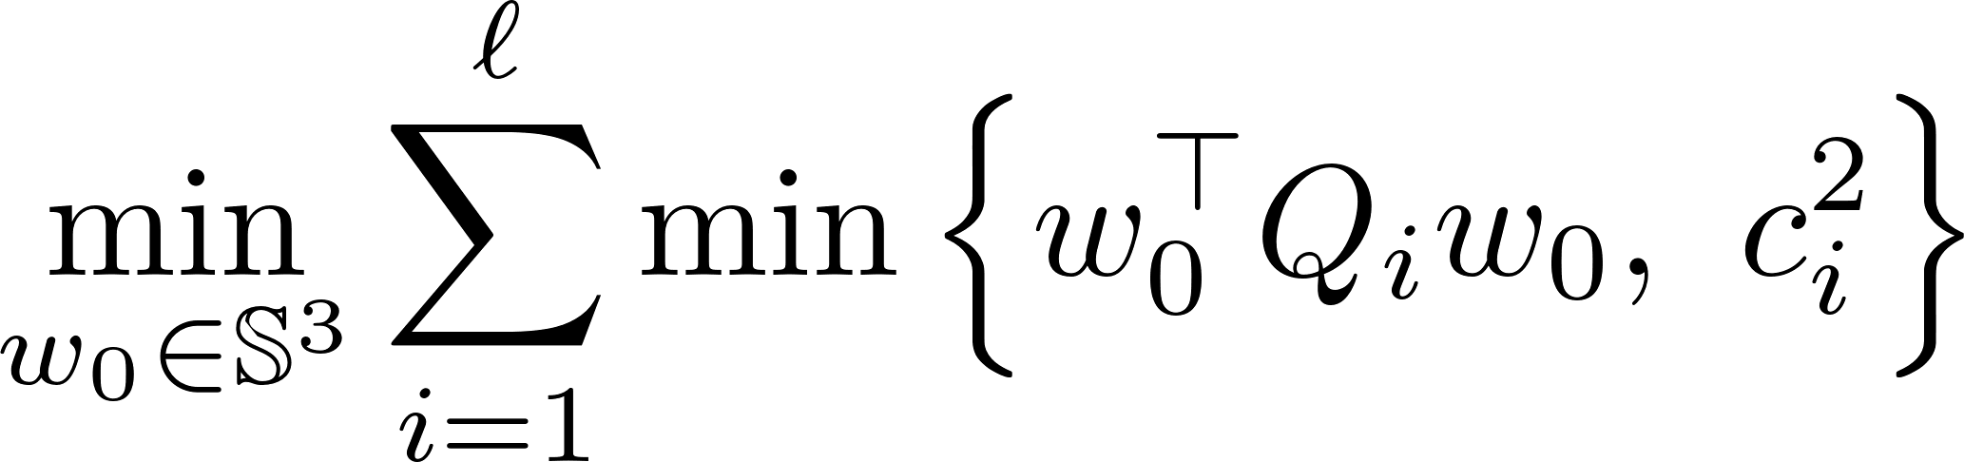
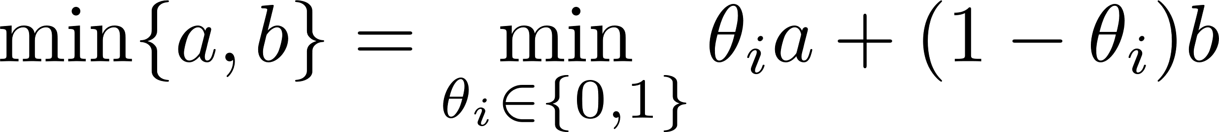
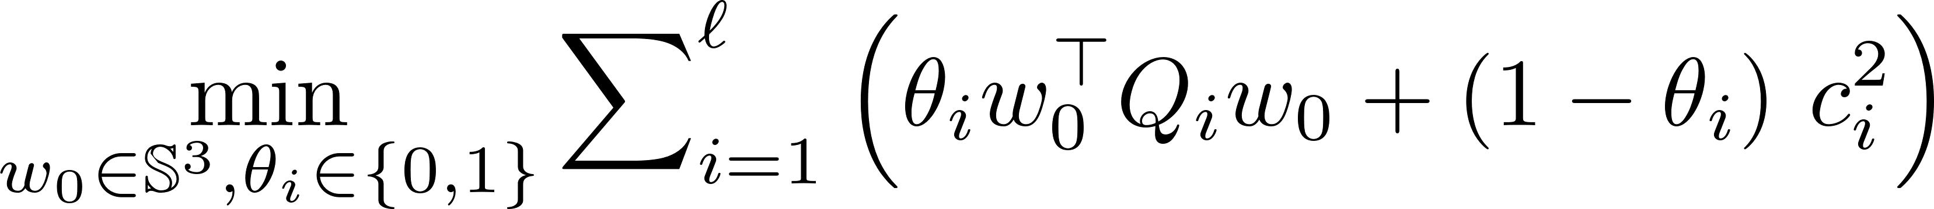

Derivation: From (TLS-R) to (SDR)
(TLS-R) $\underset{⇔}{(1)}$ (TLS-Q) $\underset{⇔}{\left(2\right), (3)}$ (QCQP) $\underset{⇒}{\left(4\right) lifting}$ (SDR)
Step (1): 3D rotations $R_{0} \overset{⇔}{ }$ unit quaternions $w_{0}$
Step (2): $i$-th inner min. binary choice $θ_{i}∈\{0,1\}$
(TLS-R)
(TLS-Q)
cubic

Slide 7
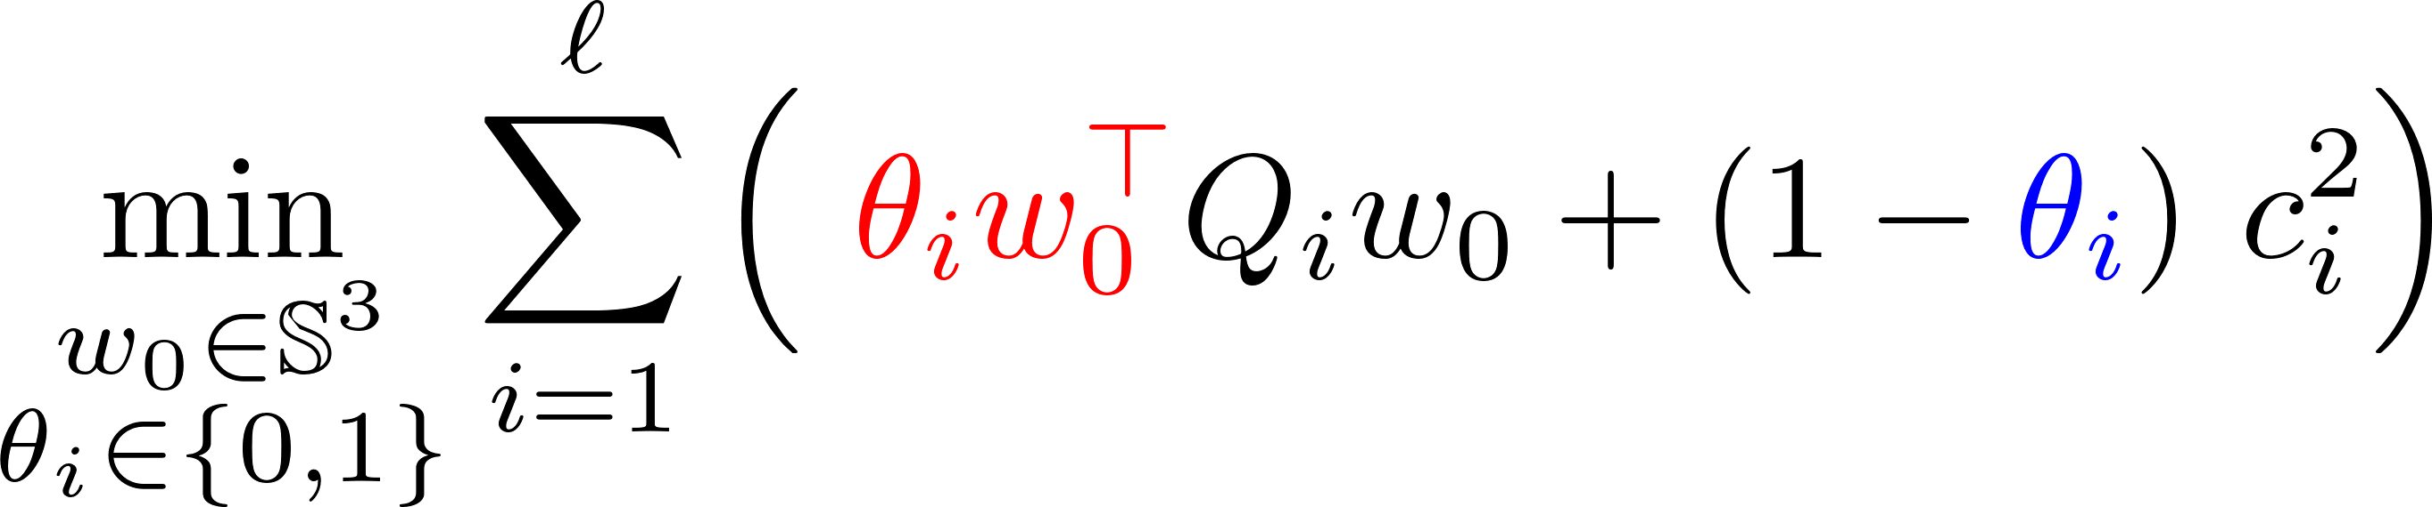
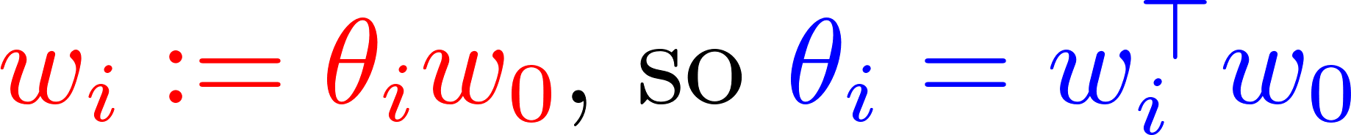
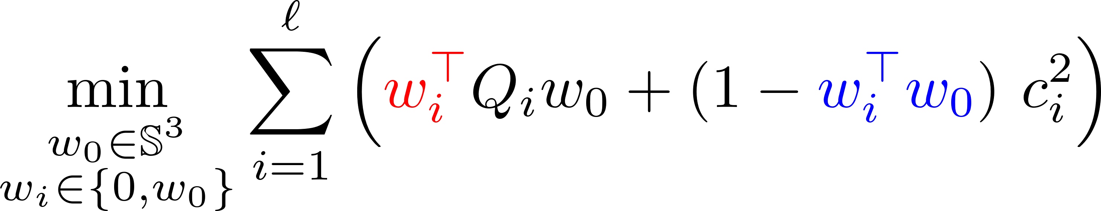

Derivation: From (TLS-R) to (SDR)
(TLS-R) $\underset{⇔}{(1)}$ (TLS-Q) $\underset{⇔}{\left(2\right), (3)}$ (QCQP) $\underset{⇒}{\left(4\right) lifting}$ (SDR)
Step (3): “binary clone” [1]:
(QCQP)
[1] H. Yang and L. Carlone. A quaternion-based certifiably optimal solution to the Wahba problem with outliers. ICCV 2019.

Slide 8
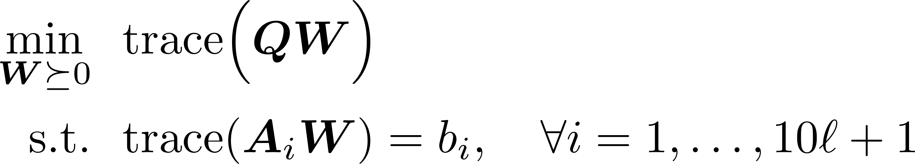

Derivation: From (TLS-R) to (SDR)
(TLS-R) $\underset{⇔}{(1)}$ (TLS-Q) $\underset{⇔}{\left(2\right), (3)}$ (QCQP) $\underset{⇒}{\left(4\right) lifting}$ (SDR)
Step (4): Lifting (a very standard step)
(QCQP)
(SDR)
[1] H. Yang and L. Carlone. A quaternion-based certifiably optimal solution to the Wahba problem with outliers. ICCV 2019.

Slide 9

Tightness of (SDR): Main Results (Informal)
Adversarial outliers can be some point pairs $(x_{i},y_{i})$ that are related by a different rotation $R$ than ground-truth $R_{0}^{∗}$, e.g.,
${y_{i}=Rx}_{i}$ for some indices $i$
Positive Result:
(SDR) is tight for small noise and random outliers.
Negative Result:
(SDR) is not tight for “adversarial” outliers, even without noise.

Slide 10
More Information
This work was supported by grants NSF 1704458, NSF 1934979, and ONR MURI 503405-78051
Vision Lab @ JHU http://www.vision.jhu.edu
Center for Imaging Science @ JHU http://www.cis.jhu.edu
Mathematical Institute for Data Science @ JHU http://www.minds.jhu.edu
Thank You!

